Slide 1
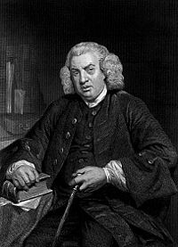
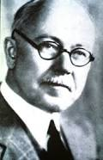

Game Of Advertising
The trade of advertising is now
so near to perfection that it is not easy to
propose any improvements
The Competent advertising man must understand psychology

Slide 2
Recharge Your Brand
Awareness/familiarity with Brand
Ad Peepal – Mobile Advertisement
Information re Brand Attributes or Benefits
Ad Exposure
Creation of Brand Image/personality
Association of feelings with brand
Reminder or inducement about brand trial

Slide 3
Marketing Your Brand
Situation Analysis
Applications for Niche Segment
Marketing Program
Pricing and promotion is based on customer profiling
Advertising Plan
Execution
App is designed based on what customer wants
Based on customer segmentation , ad is wrapped around applications
Creating of smart marketing plan covering 80% of word segment
Dedicated team for executing the plan
Daily monitoring of Key KPI’s

Slide 4

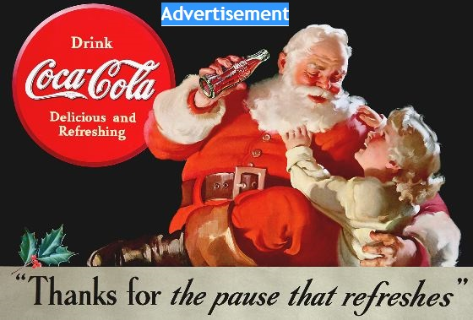

Brand Destination
Platform
People
Advertiser
coke
youth
AdPeepal = Connecting Advertisement with people

Slide 5
Leading OEM KPI’s
Leading OEM KPI
Unique visitors are 0.4 million
Downloads are 9 million
Download per unique customer is 20

Slide 6
Leading OEM KPI’s

Slide 7
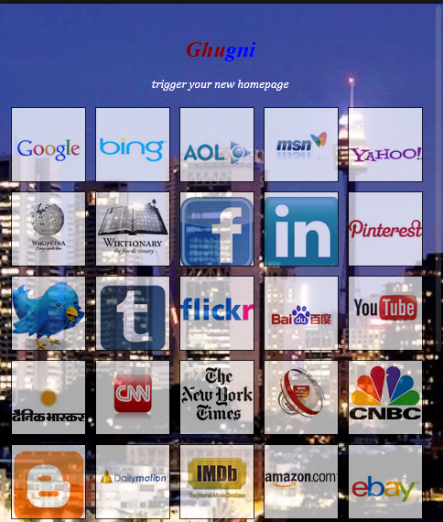






Bouquet Of Applications

Slide 8


Why Niche Applications
Applications cater to extra niche space: Specific needs
Example
Extra Niche
Specific needs
App Solutions
Newspapers
Hindi
India
Uttar Pradesh
Kanpur
This is the extra niche
space we cater to in our
Products
It covers the local district level news.
Customized exclusively for residents of UP
Conclusion – Consumers look for extra niche applications in every segment/category
My Peepal understands and cater those needs.

Slide 9
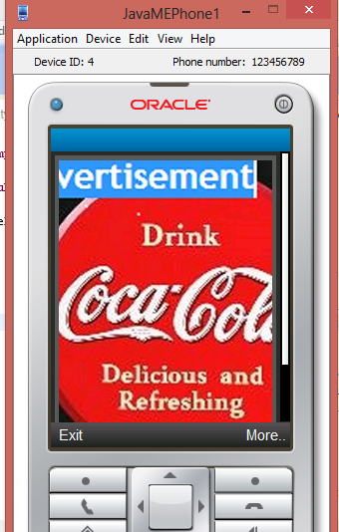
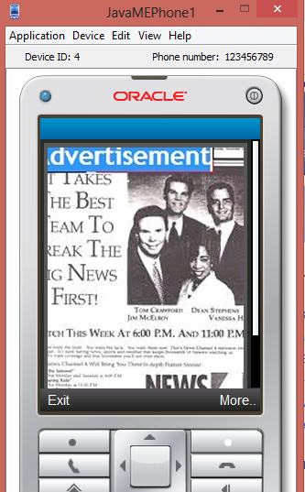
Java Applications With Advertisement

Slide 10
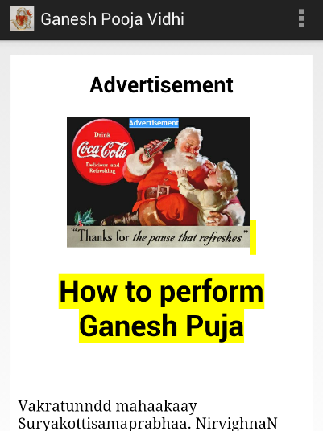
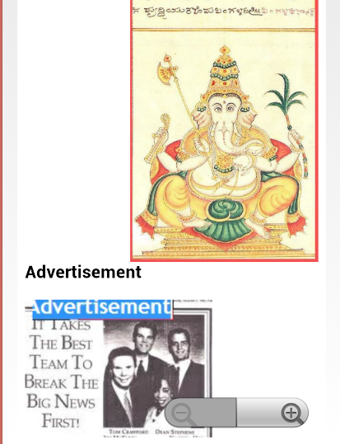
Android Application With Advertisement
Header
Footer

Slide 11

Why us ?
Maximum reach
Strategic Approach
Educated consumer Base capturing
Consumer Feedback

Slide 12
“Not everything that can be counted counts, and not everything that counts can be counted.”
– Albert Einstein
Wanna get in touch with us ?
Email-support@mypeepal.com

